Slide 1
DRAKE UNIVERSITY
EDUCATIONAL LEADERRSHIP DIGITAL BADGING INITIATIVE

Slide 2
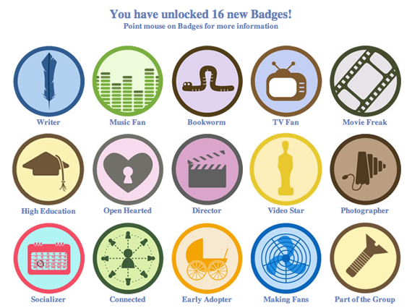
What is a Digital Badge?
Visual Representation of achievements, skills, learning

Slide 3
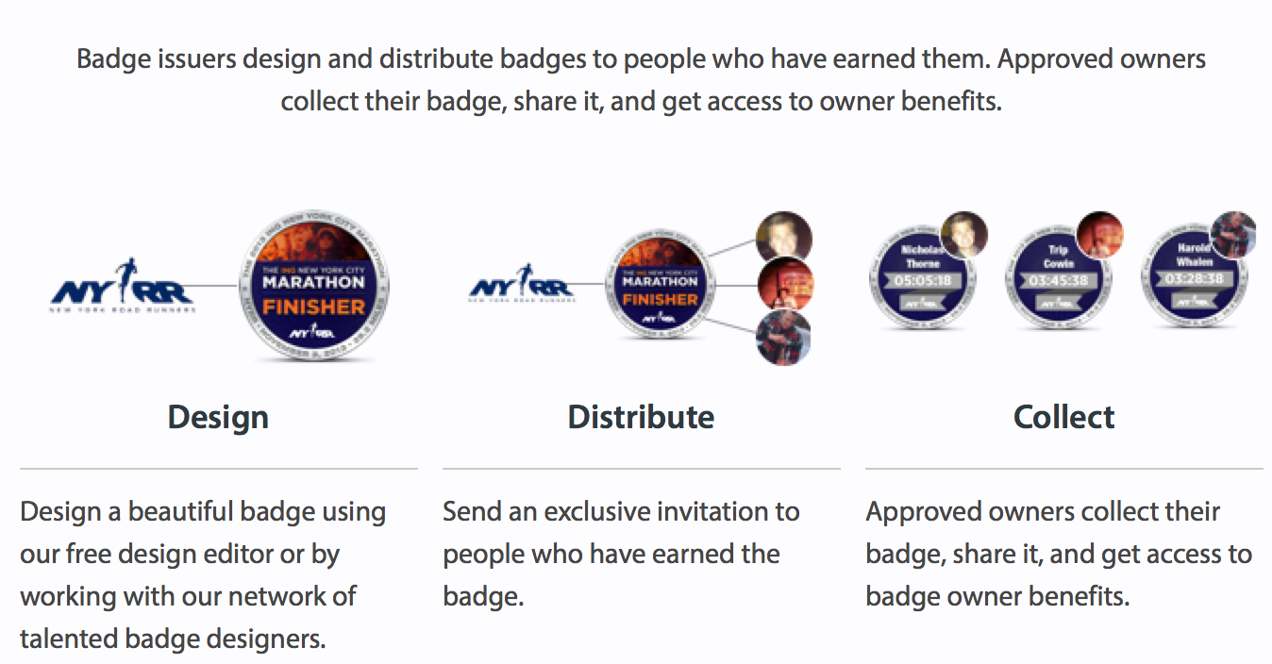
How it works

Slide 4
Digital Badging Goals for Drake:
21st Century recognition for student accomplishments.
Forward-thinking strategy to market Drake University programs.
Cost effective way to market programs.
Personalized way to showcase student accomplishments.

Slide 5
About Basno
About Basno (http://www.basno.com)
New York based company that specializes in the digital badging concept.
Basno has a new LinkedIn feature that makes it possible for badges to be added in a permanent position under the users online resume (not just the status updates in a users feed).
Basno promotes analytics of over 50% of users who permanents add their badge to their LinkedIn profile and 70% of badge owners who add their badge to Facebook.
Your digital badge will come directly from Basno.

Slide 6
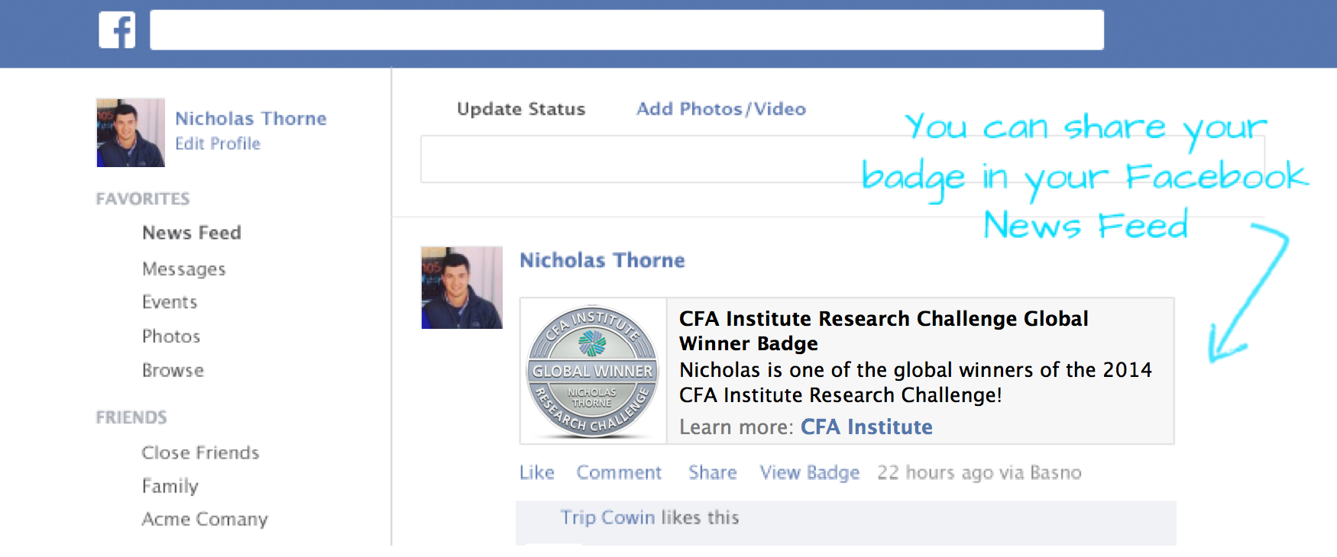
Sharing on Facebook

Slide 7
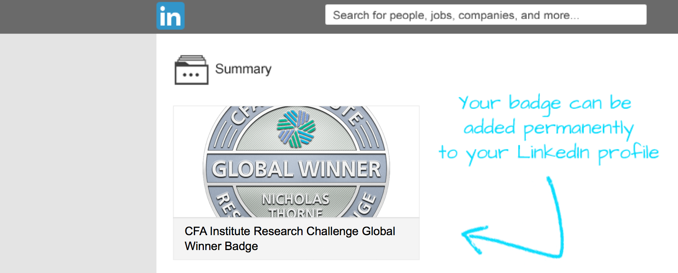
Sharing on LinkedIn

Slide 8
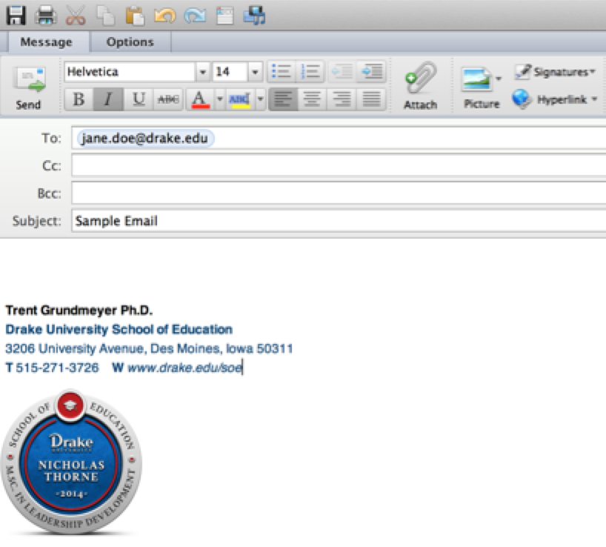
Sharing on Email

Slide 9
Sharing on other platforms
ePortfolios Websites Google Sites Blogs Wikis

Slide 10
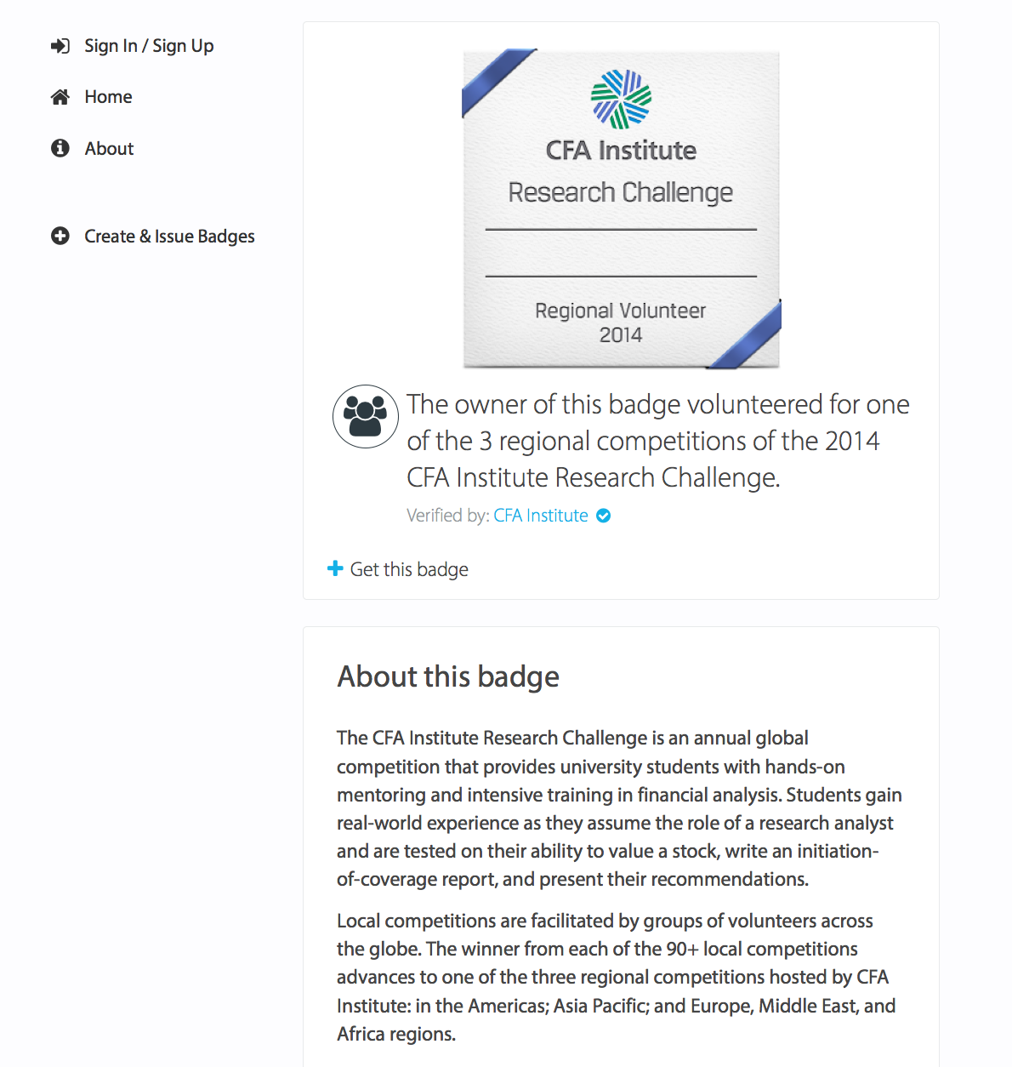
Web-page personalized to you

Slide 11
Congratulations!
Share your accomplishment!

