Slide 1
EDS Clinical
Problem & Opportunities of Practice

Slide 2
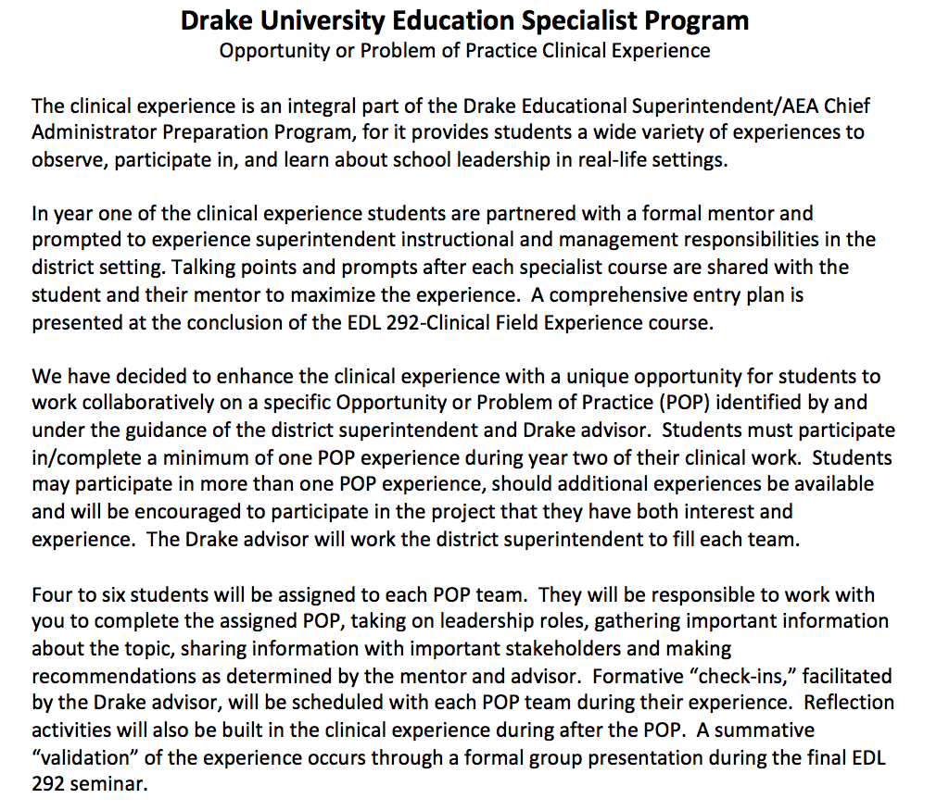

Slide 3
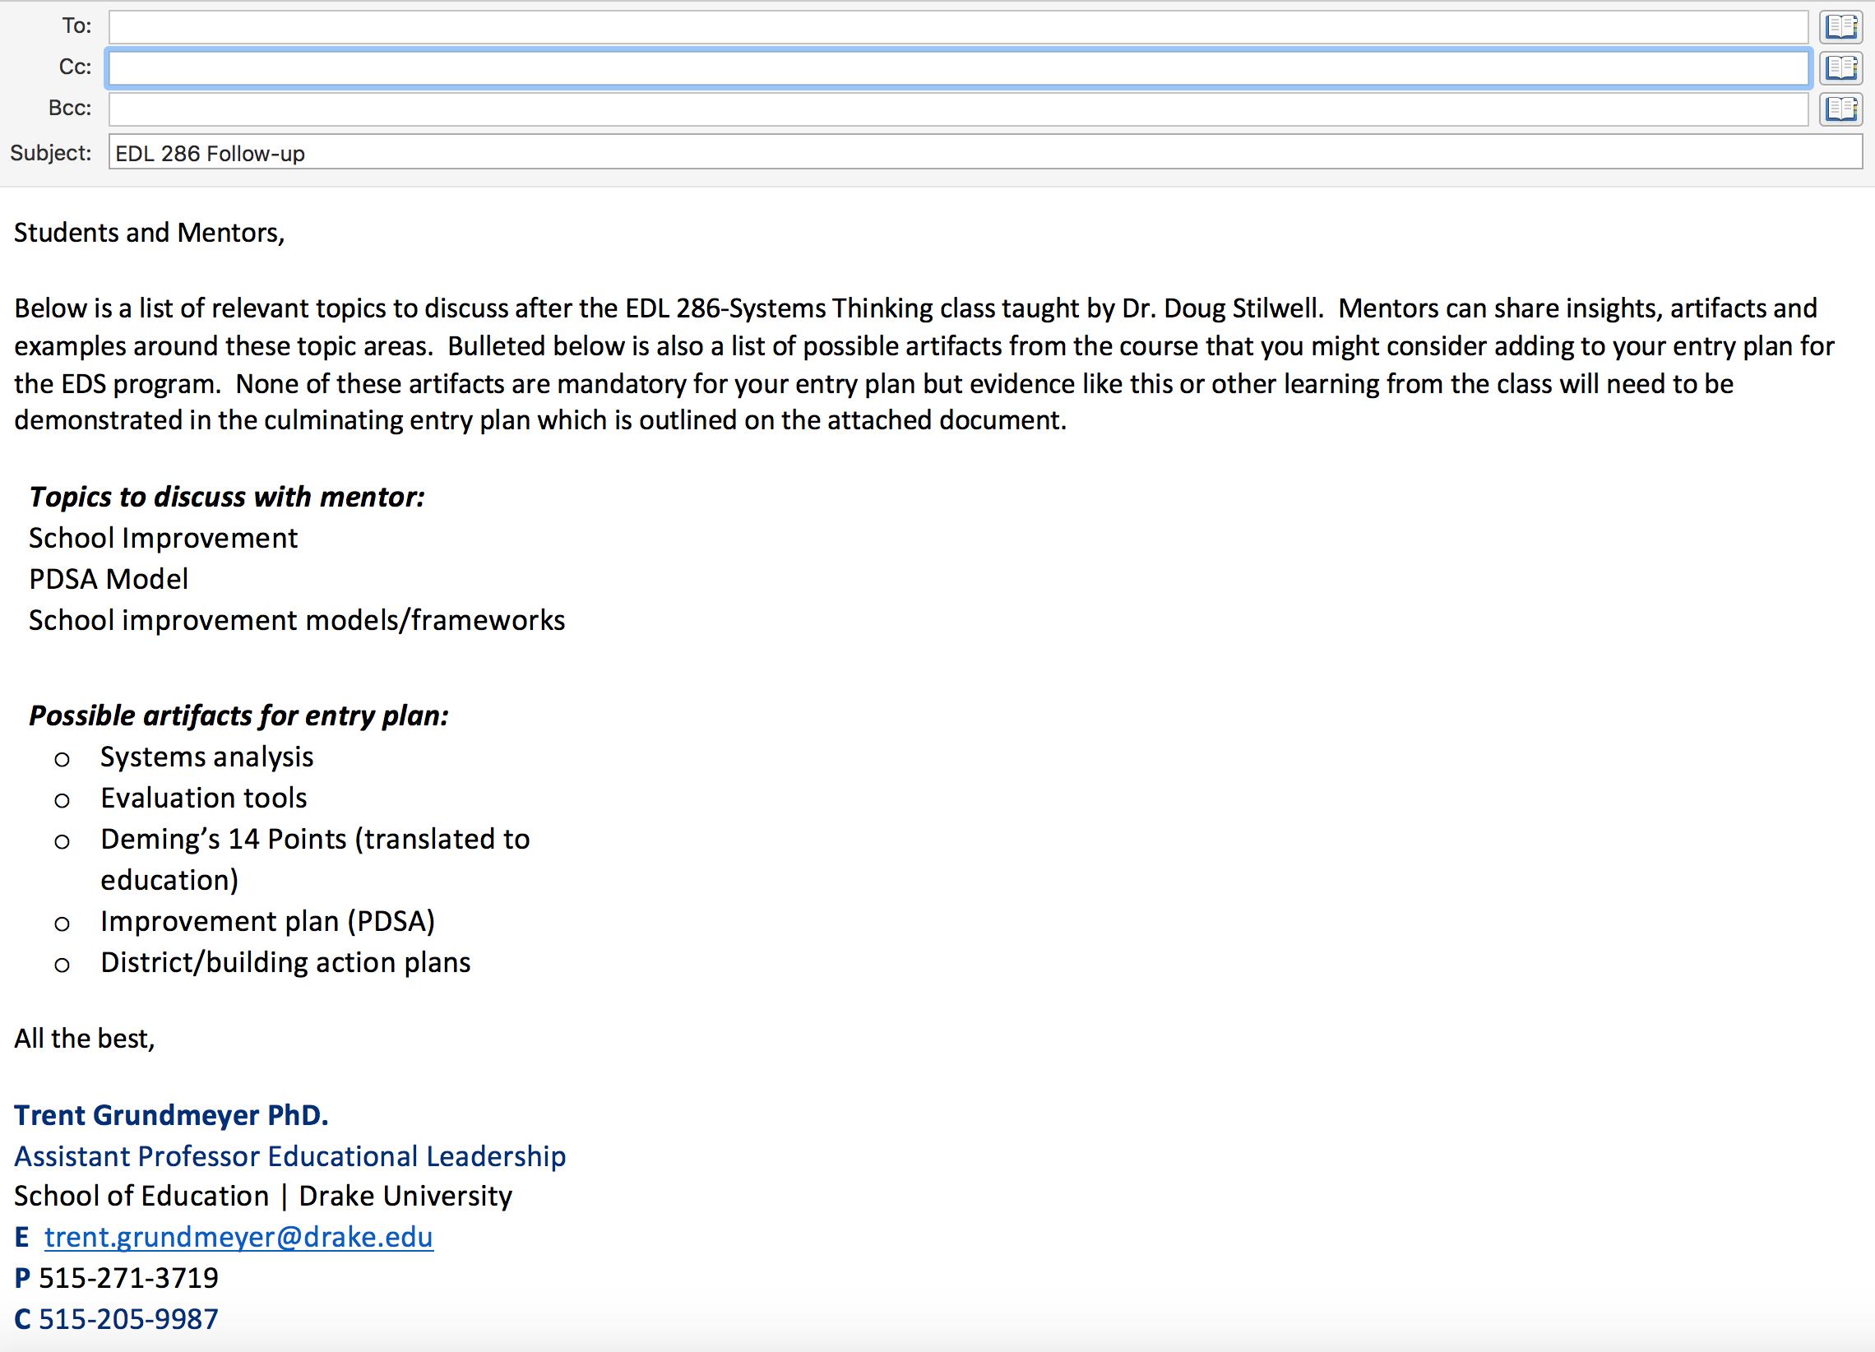
Program emails with talking points

Slide 4
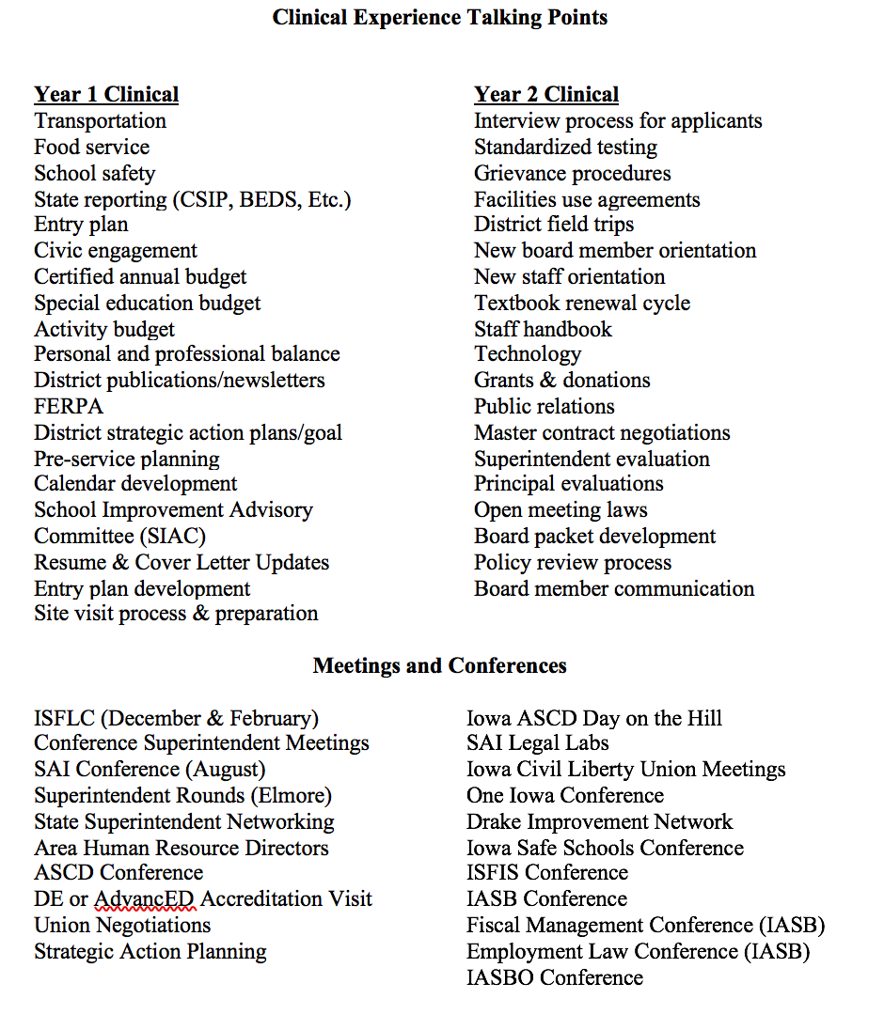
Clinical Talking Points & events

Slide 5
Community Input survey
School District
Project overview
Norwalk
Meet with the administrative team
Review baseline data
Develop a community input survey
Analyze survey feedback
Create report
Providing the supt. recommendations to share with the board
Superintendent
DT Magee

Slide 6
Increasing Parent engagement
School District
Project overview
Winterset
Evaluate baselined data on parent engagement in the district
Review research about parent engagement
Talk /Interview parents
Identify leverage points to improve parent engagement
Evaluating what other districts have done successfully to increase parent engagement throughout the district
Providing the supt. recommendations to share with the board
Provide staff strategies and ideas to promote parent engagement
Superintendent
Susie Meade

Slide 7
Budget cutting
School District
Project overview
Pleasantville
Understand the current districts financial situation
Evaluating what other superintendents/boards have done to manage the budget cutting process
Learn from experts in the field about finance and budget current processes
Consider options to reduce the budget or increase revenue
Providing supt. recommendations/strategies
Support supt. & School board through budget cutting process
Superintendent
Dr. Tony Alysworth

Slide 8
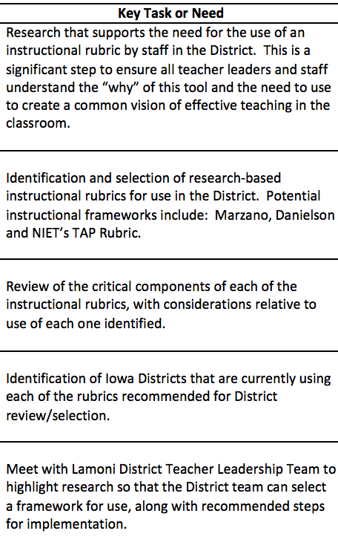
Development of Instructional Framework
School District
Lamoni
Superintendent
Chris Coffelt

Slide 9
Dev. Talented & Gifted Program
School District
Critical Question: What does a comprehensive Talented and Gifted Program look like in a rural school district?
Central Decatur
Superintendent
Chris Coffelt

