Slide 1
Drake SCHOOL OF EDUCATION Graduate STUDENT registration
Link to schedule
CLICK ON THE LINK ABOVE TO SEE THE SCHEDULE OF CLASSES

Slide 2
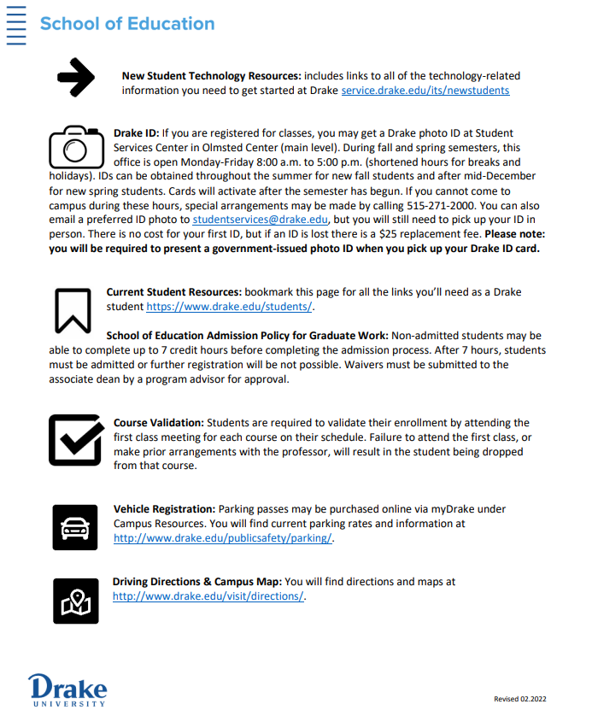

Slide 3
Schedule link
When you view schedule, please note the CRN, or course registration number. You will need this information on the add classes worksheet. Example shown below.
FOUNDATIONS OF EDUC GRAD - 1581 - EDUC 203 - 0
https://mydusis.drake.edu/prodssb/bwckschd.p_disp_dyn_sched
Once you determine what course(s) you are interested in taking, log in to My Drake with your drake email and password.

Slide 5
Select Classes & Registration

Slide 6
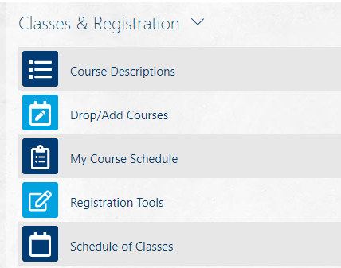
Select Drop/Add Courses

Slide 7
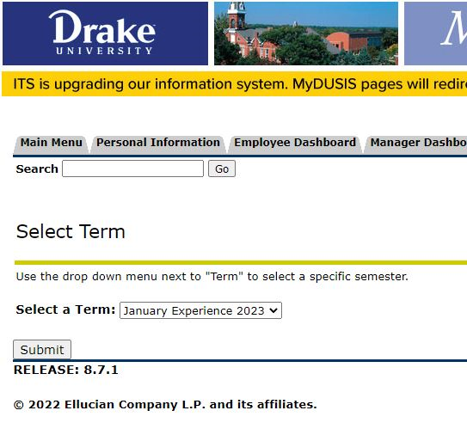
Select the term for which you want to register. Then hit the Submit button.

Slide 8
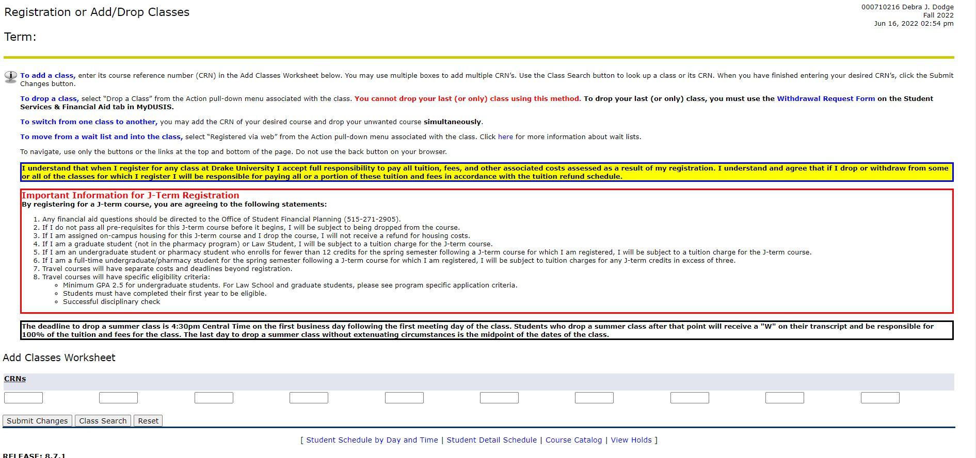
Add the CRN for the course(s) that you want to take and click Submit Changes.

Slide 9
Questions or Problems?
Reach out to Debbie.dodge@drake.edu 515.271.3727
Provide the following information:
Drake ID number
Term you are registering (fall, spring, summer and year)
CRN of the course(s)
Description of your problem

