Slide 1
Iowa Administrator Licensure Application Process
Iowa Board of Educational Examiners

Slide 2
Tips
Use Chrome (best), FireFox or Safari.
Do not use Explorer
Cookies will need to be activated to pay online.
Application should take 10-20 minutes to complete.
You may leave and return as needed.
Remember your login email and password.

Slide 3
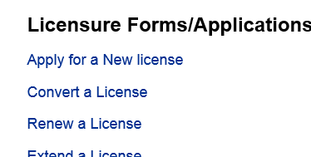
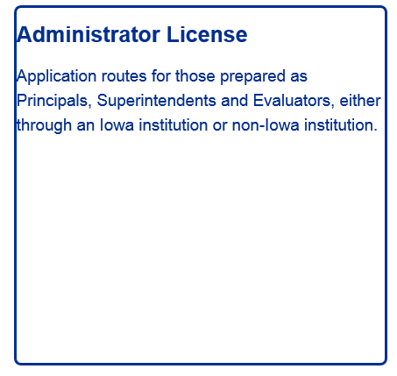
Iowa Administrator Graduates Application – Applicant Side http://www.boee.iowa.gov

Slide 4
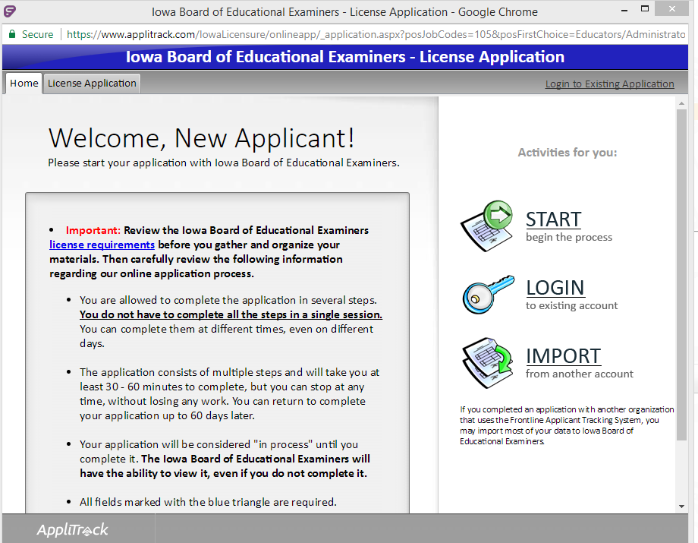
Logging In
Start – Never applied for a BoEE license on this new system
Login – Applied for a prior license on this new system (Teaching, Coaching Sub Auth, Para etc.)

Slide 5
Account
The email is your login name.
The email you chose should be a stable account. One that will not change with employment, institution etc.
When you login, if you get the statement “SSN already in use” you already have an account in this system under another email login.
Contact Jeff DeBruin at the BoEE
jeff.debruin@iowa.gov / 515-242-6797

Slide 6
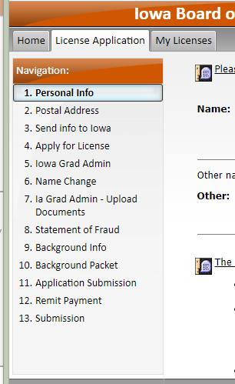
Navigation
Home – Login
License Application – the application your are applying for
My Licenses – PDF’s of licenses generated in the BoEE’s new system. Active and expired

Slide 7
You can save your application as you move along, and move from page to page with icons at the bottom of the page

Slide 8
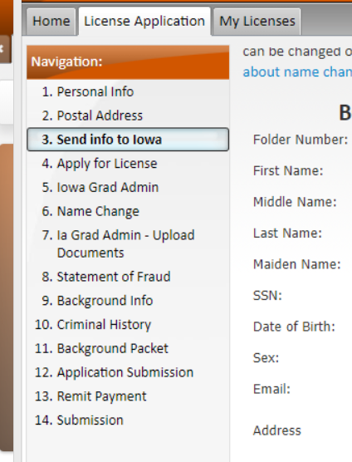
Demographics
Steps 1, 2, and 3.
Step 3, “Date of Birth” and “Gender”, the rest should be compete. Watch the year on “Date of Birth”.
Click “Send Info” at the bottom center of the page!!
This generates or pulls your folder number from our database.

Slide 9
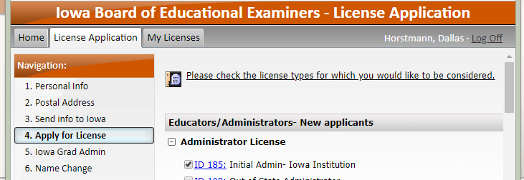
Apply for a License
“Initial Administrator –Iowa Institution…” Should be checked. This should be the only application checked.
Checking other applications increases the number of pages in the application.
Increases fees.
You may apply for multiple licenses if you are eligible, not recommended.

Slide 10
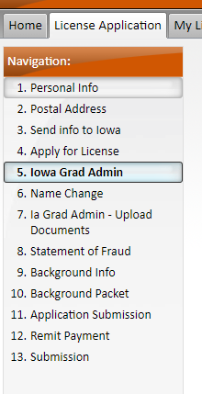
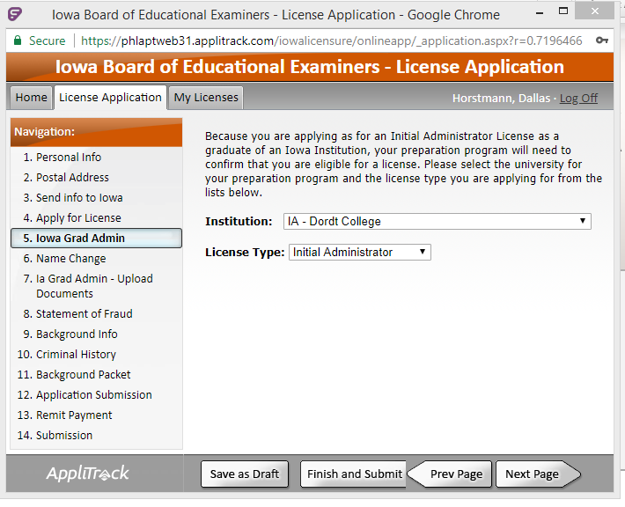
Pull down menus Choose College and choose License Type

Slide 11
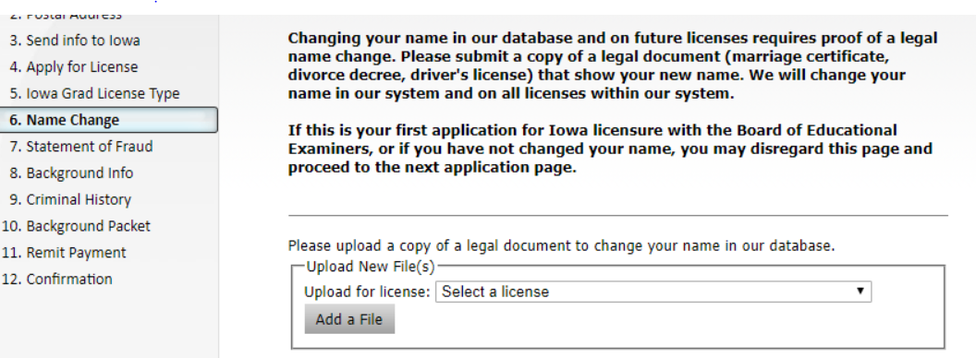
Name Change
Only needed if you have an existing license in our system (new or old) under a prior name.

Slide 12
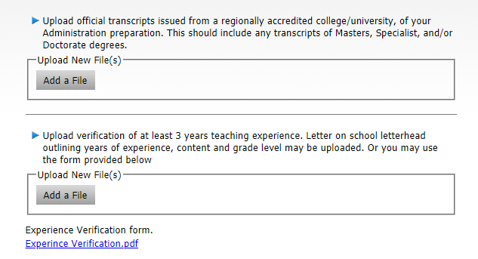
Iowa grad admin uploads
Upload official transcripts form Iowa Adm. Program
Upload 3 years of teaching experience.

Slide 13
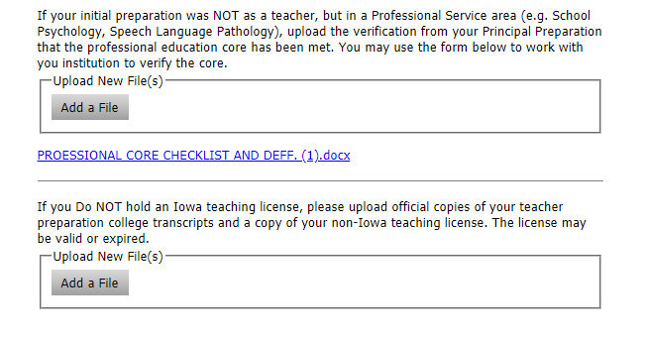
Iowa grad admin uploads continued
If you do not have a standard or master educator license.
If you do not have an Iowa Teaching license.

Slide 14
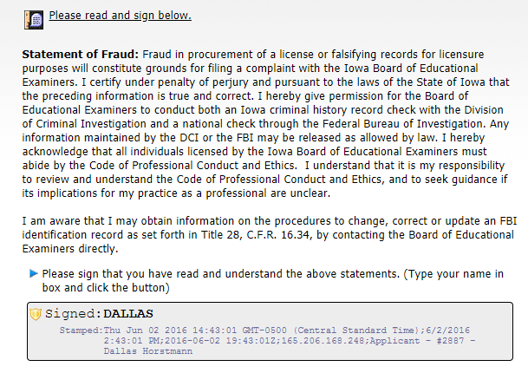
STATEMENT OF FRAUD

Slide 15
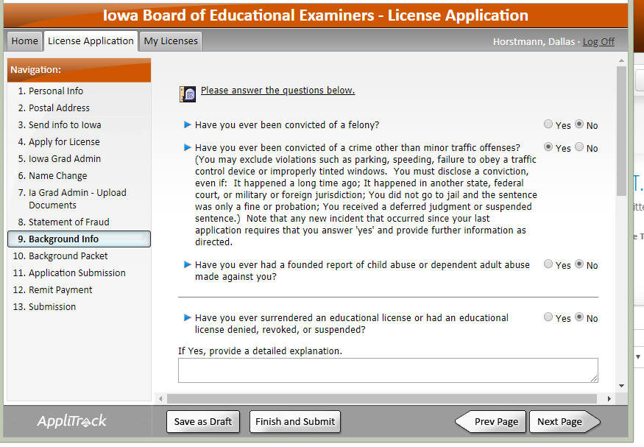
Background Information
Any except minor traffic offenses.
IF YOU CHECK YES THIS WILL OPEN NEW PAGES FOR YOU TO DISCLOSE INFORMATION.
Failure to complete slows process.

Slide 16
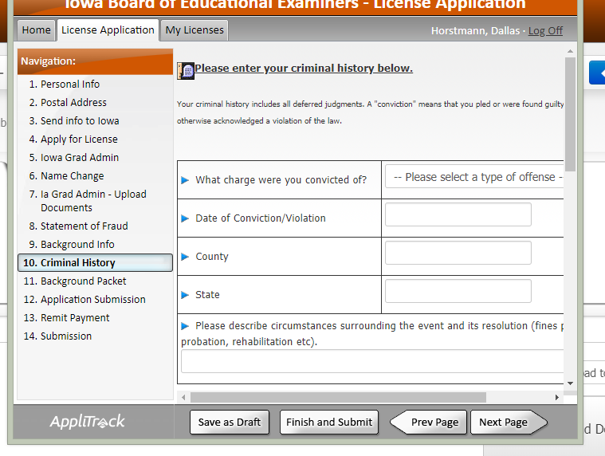
Criminal History
Pull down of most common.
Choosing “Other” generates a text box.
Once done, it will carry over to all applications.
Can add new ones (if needed) for future applications.

Slide 17
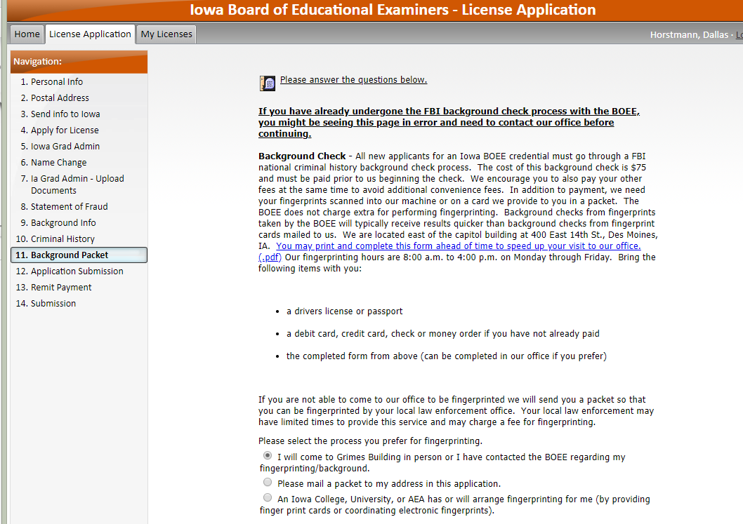
BACKGROUND PACKET
You will need a FBI background check if you have not had one. (please call our office if you have questions)
Option 1) You will physically come to Des Moines, and be fingerprinted in our office.
Option 2) You are requesting a fingerprint packet be mailed to you , so you can go to a police station to be fingerprinted, and mail the card to the BoEE
Option 3) Your college is handing you fingerprint cards, or arranging the BoEE to come to your college to be electronically fingerprinted.

Slide 18
Fees
If you have a license with the BoEE (issued after October 1, 2000)
Teaching
Coaching Authorization
Substitute Authorization
Para-educator Certification etc.
Total Fee $88.00
If you have never had a full background check with the BoEE, a background check is required.
Total Fee $163.00

Slide 19
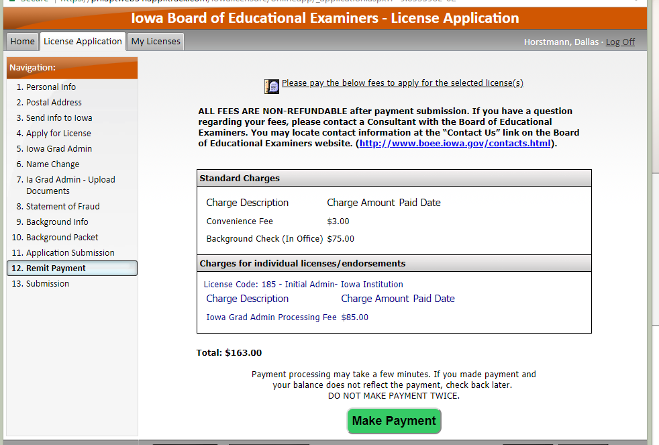
Fees
“Total” amount will be the fee that is charged with “Submit Payment”. If you feel it is incorrect
1) check “Apply for a License” to see if more than one application checked.
2) Contact our office.
All submitted fees are non-refundable!

Slide 20
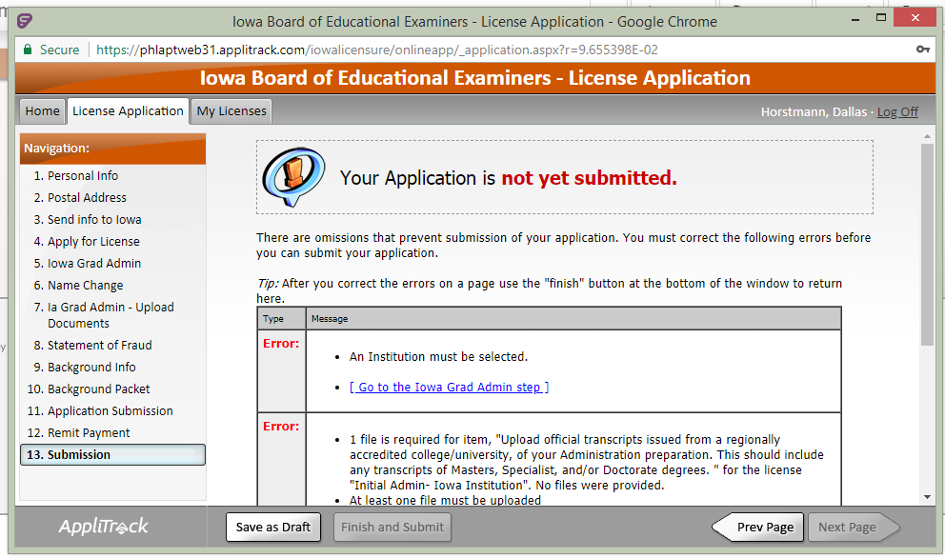
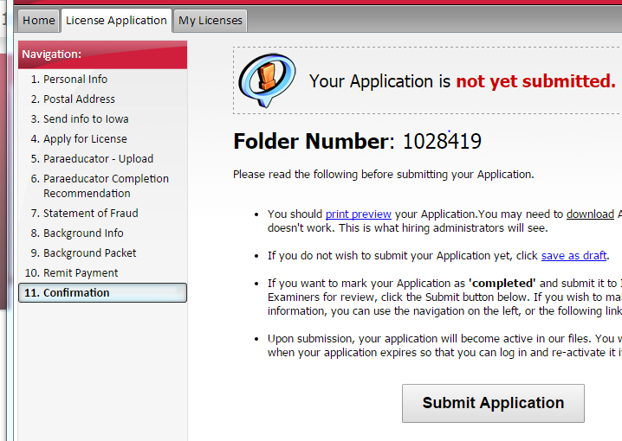
Confirmation
Payment and Submission are two separate steps. ALWAYS go to confirmation step. It will tell you what is missing.
Or
Ready to Submit

Slide 21
Issuance
Once issued, the license will be sent as an email PDF. This will come from an AppliTrack or MailBot account. Check SPAM filter
Can always print off PDF’s from your “My Licenses” tab.

Slide 22
Contact Info or FAQs
Fingerprint cards Danielle Brooks 515-2813482
Pay by Check / Money Order Mail to the BoEE (indicate folder number)
Credit Card Didn’t Work Jeff DeBriun 515-242-6797 / jeff.debruin@iowa.gov
Refunds WE DO NOT ISSUE REFUNDS
SSN Already in Use Jeff DeBriun 515-242-6797 / jeff.debruin@iowa.gov

