Slide 1
Mydrake
HELP ME UNDERSTAND WHAT I NEED TO KNOW

Slide 2
Here is your mydrake student homepage Drake’s campus portal

Slide 3
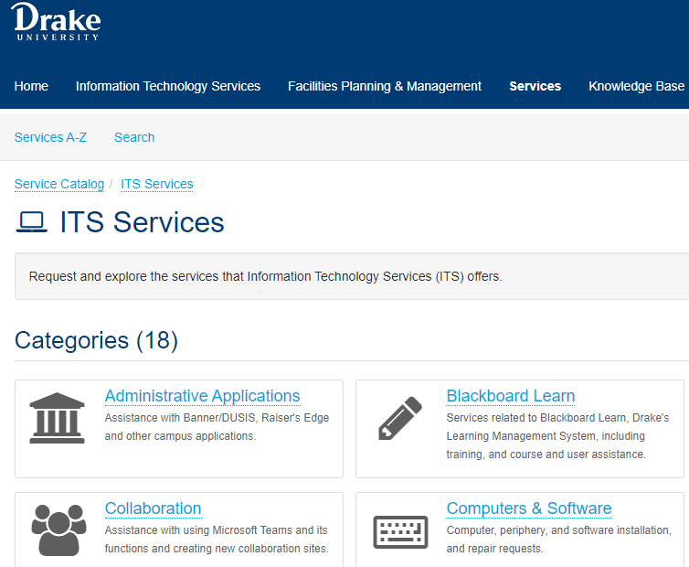
It service portal
Visit the IT portal to view popular services. Phone assistance 515-271-3001.
https://drake.teamdynamix.com/TDClient/2025/Portal/Requests/ServiceCatalog?CategoryID=6673

Slide 4
Student Records Here is where you find your unofficial transcript, documentation for proof of enrollment, graduation application, etc.

Slide 5
myDrake FAQ
https://www.drake.edu/registrar/mydrakehowto/

Slide 6
Finding your Drake Email Address (How-to)
https://drake.teamdynamix.com/TDClient/2025/Portal/KB/ArticleDet?ID=21382

Slide 7
Student account Here is where you will see your billing statement and payment options. Phone contact for Student accounts is 515-271-3097.

Slide 8
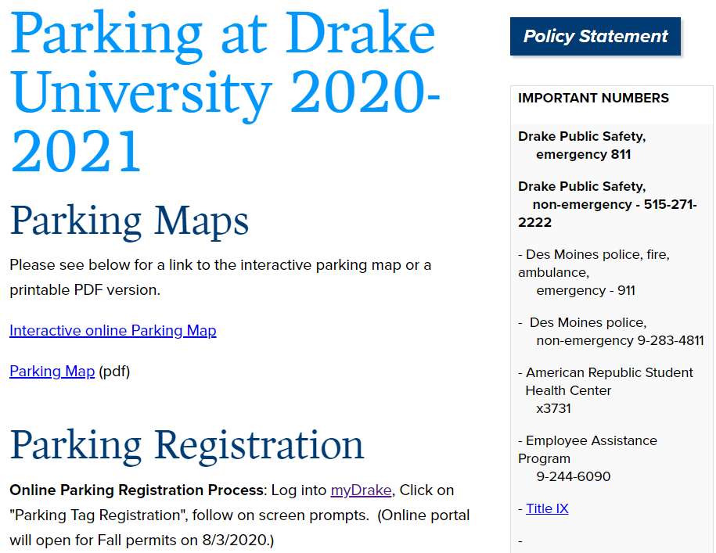
Parking info: http://www.drake.edu/publicsafety/parking/ http://www.drake.edu/publicsafety/ Campus map : drake.edu/map

Slide 9
Admitted student registration tutorial
https://drake.hosted.panopto.com/Panopto/Pages/Viewer.aspx?id=c9014e1a-e2eb-46a6-8d95-ac5500da85d0

Slide 10
Cowles library website Cowles Library Specialist, Gillian Gremmels https://library.drake.edu/find/research-guides/

Slide 11
Blackboard direct link https://drake.blackboard.com activated by instructor, when they are ready

Slide 12
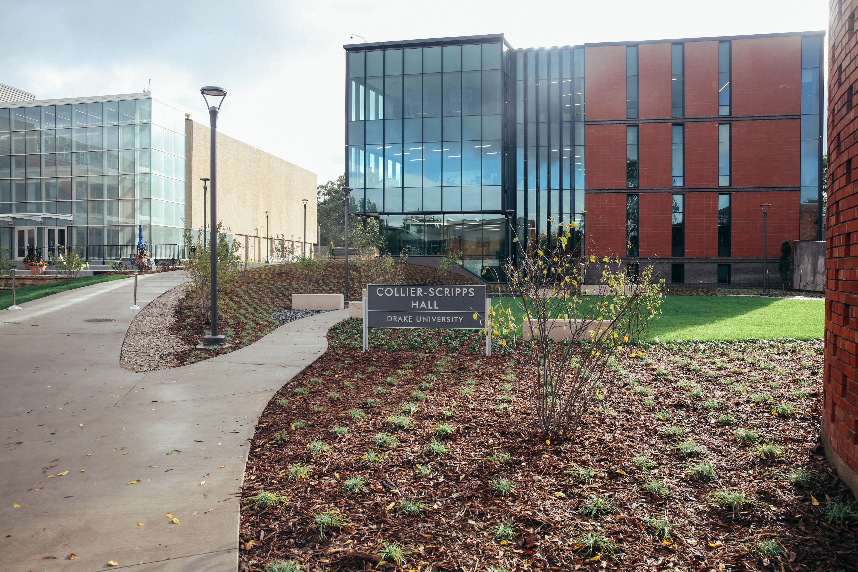
Enjoy your drake experience
Additional information available at
http://www.drake.edu/soe/about/currentstudents

