Slide 1
Polishing Your Papers
Trent Grundmeyer PhD.

Slide 2
Objectives
Applying on TeachIowa.Gov
Getting an interview
Preparing for the interview
Winning the interview

Slide 4
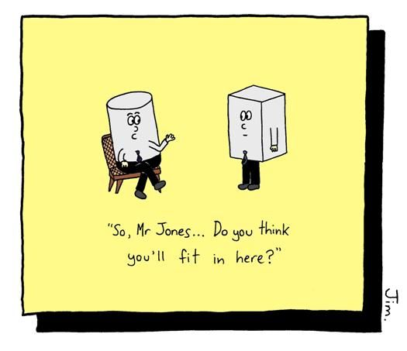

Slide 5
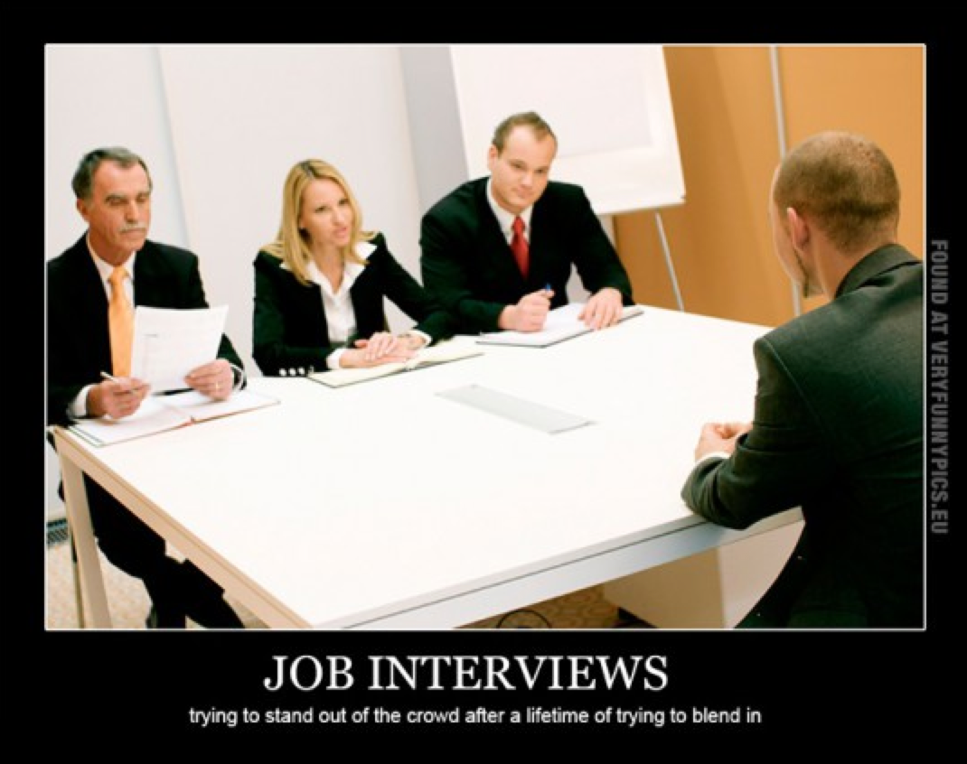

Slide 7
Applying on applitrack
Materials should be updated for each job
References?
Licensure?
Disclosing Criminal Charges?

Slide 8
Getting an interview
Call for more information before applying
Ensure clean application materials
Have someone call on your behalf (if possible)
Follow-up on application materials
Consider your digital footprint

Slide 9
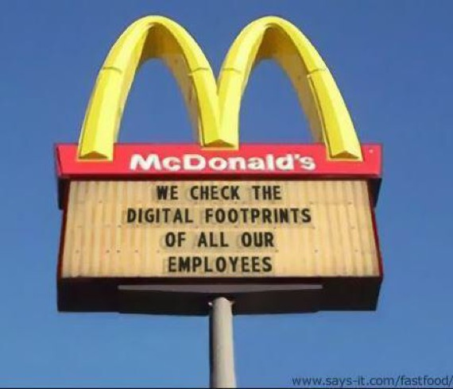

Slide 10
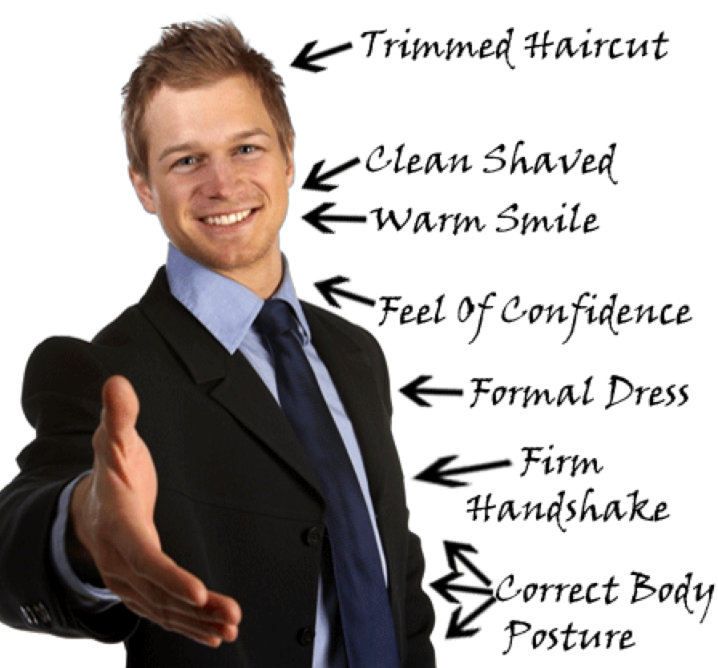
Preparing for the interview
Dress
Interview Questions (Silver bullets)
First Impressions
Body language
Artifacts and handouts
Questions for the interview team
Do your homework
DE Website
Site visit reports
District website
Stick to your routines

Slide 11
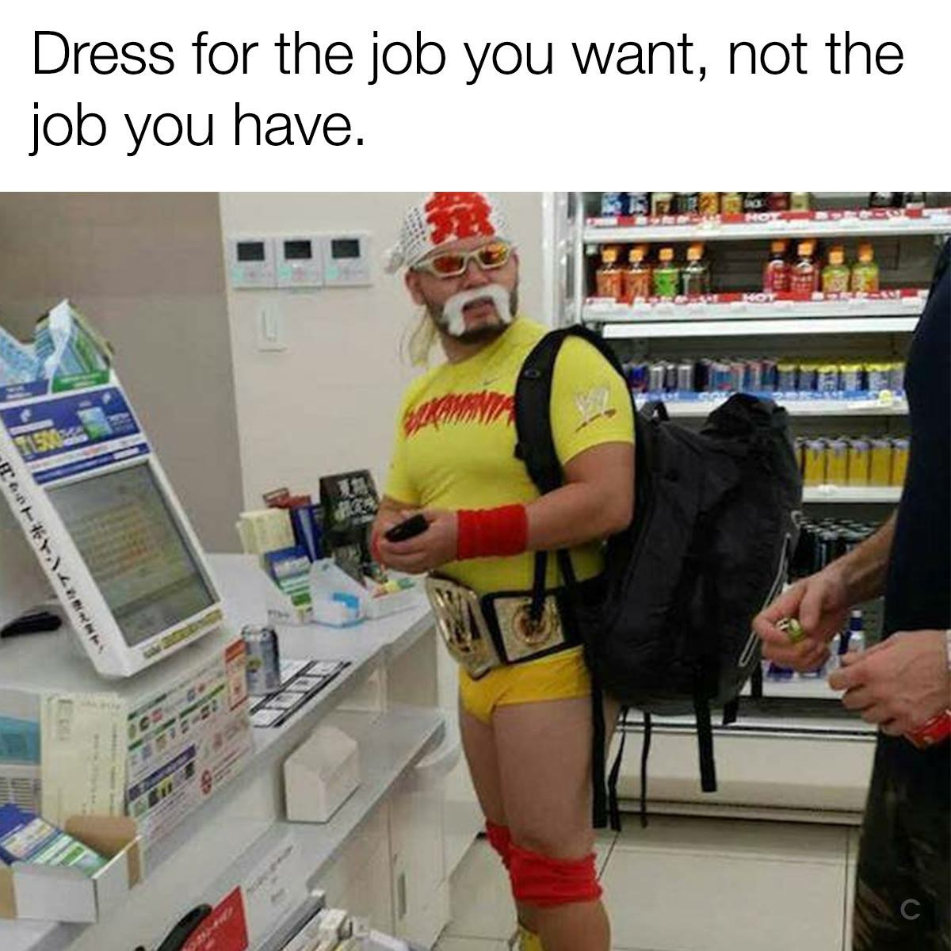

Slide 12
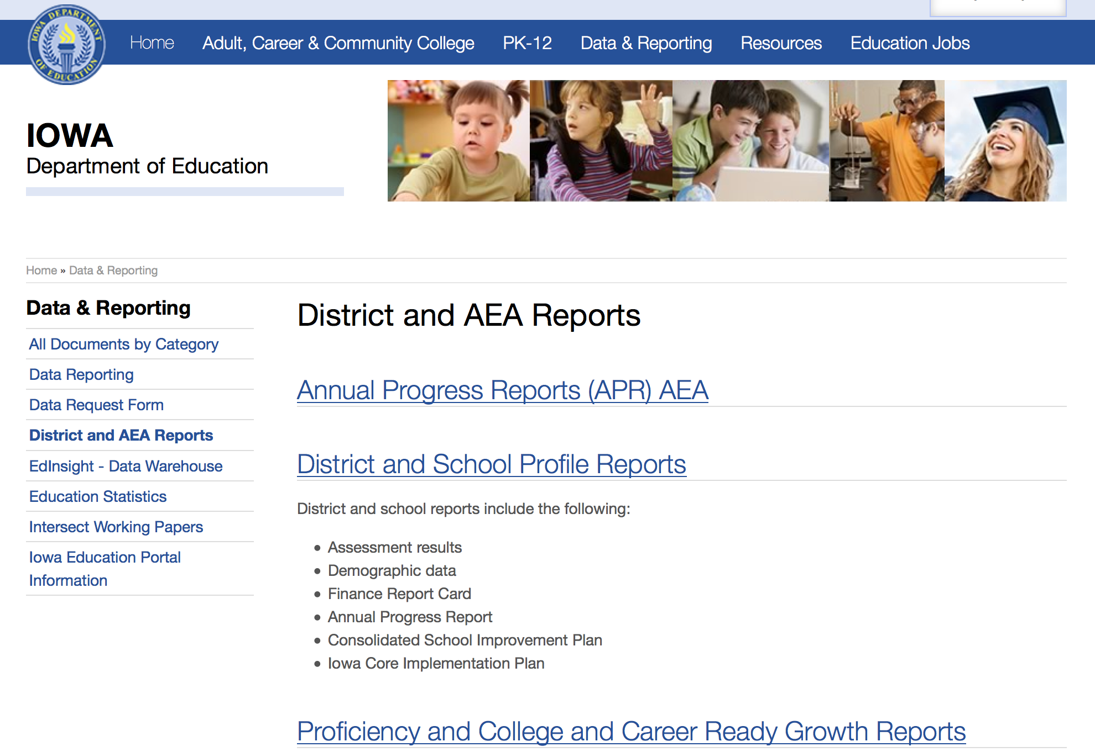

Slide 13
Winning the interview
Consider First Impressions
Make connections
Be confident
Artifacts and handouts
Make sure they know you are well-prepared
Beauty pageant answers are good (kind of)
Know when you are on and off the record
No regrets
Follow-up thank you

Slide 14
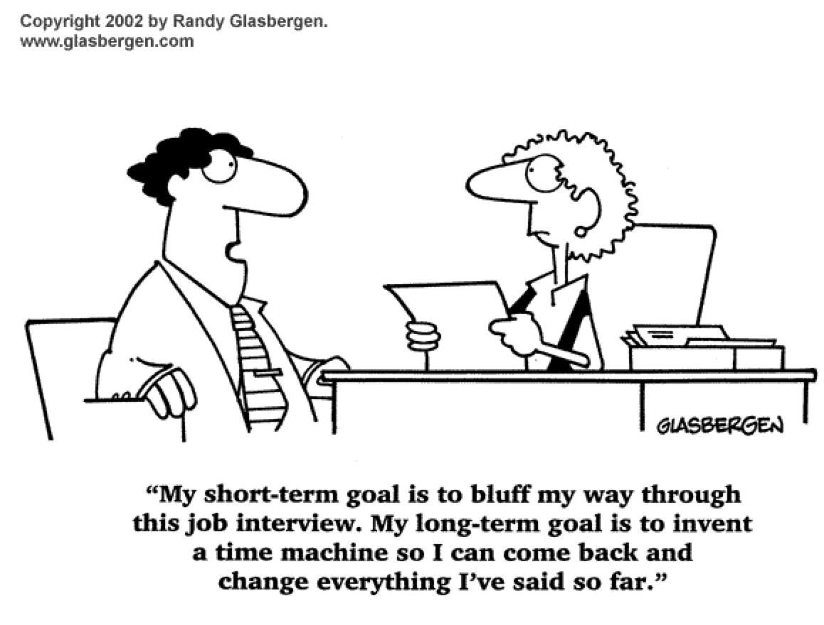

Slide 15
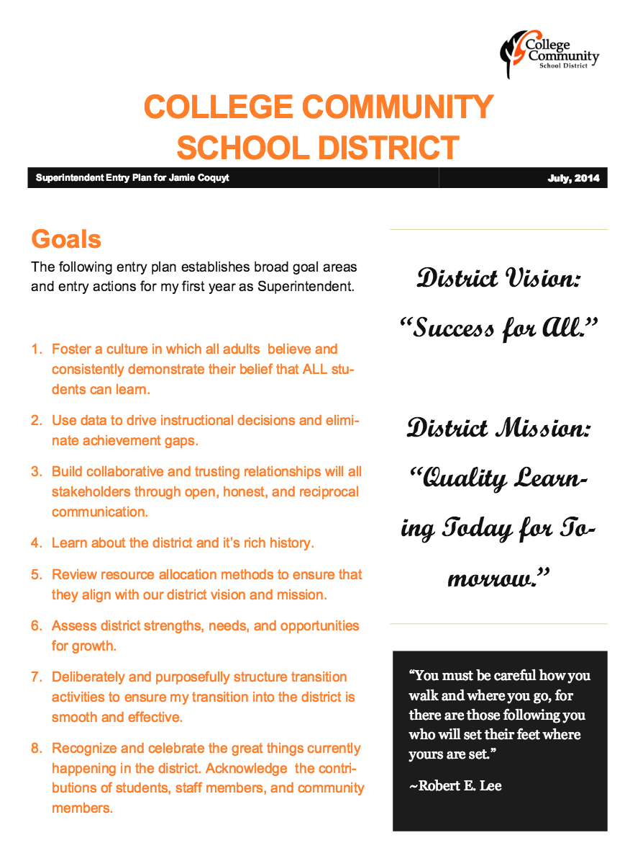
Entry Plan

Slide 16
Tough Interview Questions
On a scale of 1-100% what percent of learning is that of the student and what percent that of the teacher?
Our mission statement is… How does your philosophy of education align with our mission?
How do you balance your personal and professional responsibilities?
Describe a mistake you have made in the last year and what you learned from it?
What sets you apart from other candidates?
What decisions do you seek input and what decisions will you make on your own?

Slide 17
Website Resources

Slide 18
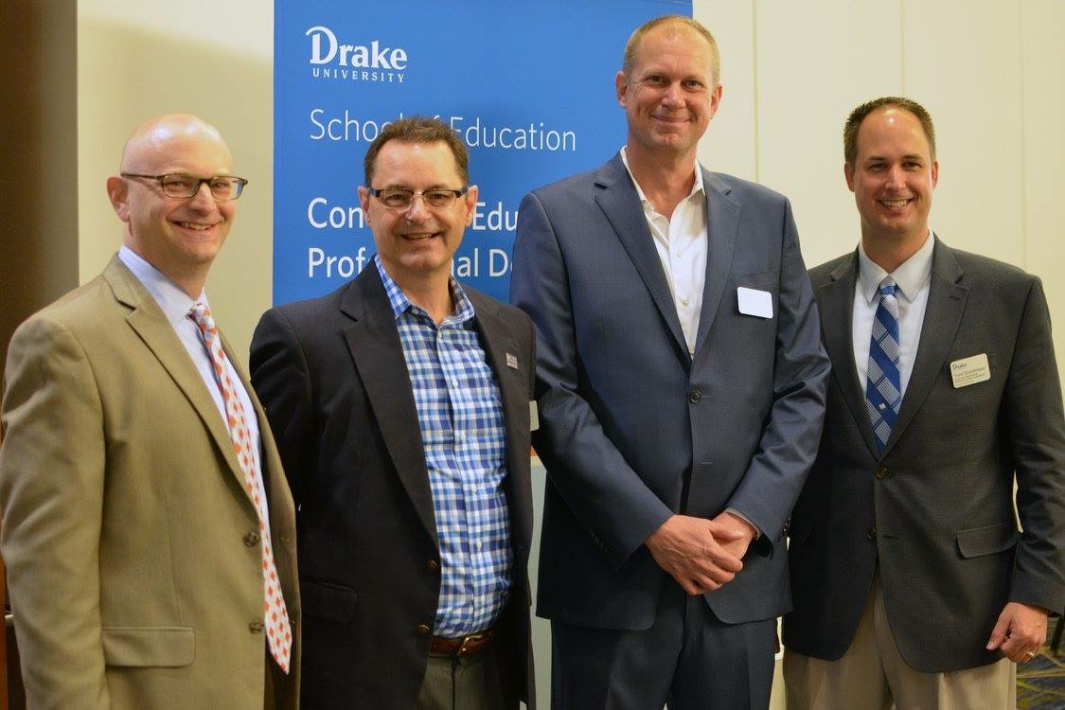
Good luck!

